Slide 1
TOPIC:
HOSPITAL MANAGEMENT SYSTEM
PRESENTED
BY
GROUP (I)

Slide 2
Abstract
Hospital Management System is an organized computerized system designed and programmed to deal with day to day operations and management of the hospital activities. The program can look after inpatients, outpatients, records, database treatments, status illness, billings in the pharmacy and labs. It also maintains hospital information such as ward id, doctors in charge and department administering.

Slide 3
Introduction
Hospital Management System is a software product suite designed to improve the quality and management of hospital management in the areas of clinical process analysis and activity-based costing.
The project Hospital Management system includes registration of patients, storing their details into the system, and also computerized billing in the pharmacy, and labs. The software has the facility to give a unique id for every patient and stores the details of every patient and the staff automatically.

Slide 4
Problems
Lack of immediate retrievals: - The information is very difficult to retrieve and to find particular information like- E.g. - To find out about the patient’s history, the user has to go through various registers. This results in convenience and wastage of time.
Lack of immediate information storage: - The information generated by various transactions takes time and efforts to be stored at right place.
Lack of prompt updating: - Various changes to information like patient details or immunization details of child are difficult to make as paper work is involved.
Error prone manual calculation: - Manual calculations are error prone and take a lot of time this may result in incorrect information. For example calculation of patient’s bill based on various treatments.
Preparation of accurate and prompt reports: - This becomes a difficult task as information is difficult to collect from various register.

Slide 5
Goals
Objectives
User friendly
Simple fast
Low cost and effective
It deals with the collection of patient’s information
Diagnosis
Define hospital
Recording information about the Patients that come.
Generating bills.
Recording information related to diagnosis given to Patients.
Keeping record of the Immunization provided to children/patients.
Keeping information about various diseases and medicines available to cure them. These are the various jobs that need to be done in a Hospital by the operational staff and Doctors.

Slide 6
UML Approach
Unified Modeling Language (UML) includes the following diagrams:
1. Use case diagram
2. Sequence diagram
3. Activity diagram
4. Class diagram

Slide 7
USE CASE DIAGRAM
Register New Patient
View Personal Information
Appointment
Patient
Bed
Edit/Update Record
Generate Report
Admin
Doctor
View Record
Medicine
Nurse

Slide 8
ACTIVITY DIAGRAM
P takes appointment
Receptionist checks for doctor
Doctor is not avail
yes
p. Consult Doctor
Patient need to be operated
No
Doctor. Attains P
yes
Undergoes operation
Surgeon Operates P
P. Gets Operated
Nurse Assist S.
No
Patient ok
yes
discharge

Slide 9
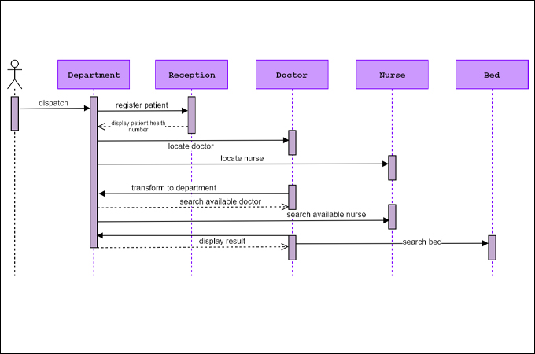
SEQUENCE DIAGRAM

Slide 10
Requirements:
There are various requirements in the HMS. Some of these requirement are system functions include Registration, Patient check out, Report generation, and more. In this blog, let's check out the functional and non-functional requirements of the Hospital Management System in depth.

Slide 11
Requirements
User Requirements
System Requirements
Adding Patients:
Logon ID:
Deleting Patient ID:
Information of the Patient:
Updating information of the Patient:
Front Desk Staff Rights:
Administrator rights:
Modifications:
Assigning an ID to the patients:
Patient Identification:
Response Time:
Capacity:
Conformity:
User-Interface:
Back-Up:
Errors:
Availability:
Availability of the Bed:

Slide 12
End

